Slide 1

Analysis of Cryptocurrency Exchange Rates and Stock prices
1533 - Data Mining and Decision Support Systems
Michael Graf, Filip Minic, Alexander Neulinger

Slide 2
Content
Idea & Scope
Gathering & Preparing Data
Explorative Analysis
Correlation-Heatmap of exchange rates
Prediction model
Monte-Carlo-Simulation on
Multivariate Normal Distribution
(Copula)

Slide 3
Cryptocurrencies
mining of bitcoin= proof of work = cryptographic puzzle → needs to be computed by processors
E.g. Nvidia processors are very efficient for mining Bitcoins
Cryptocurrencies are skyrocketing! Is there a link between cryptocurrency exchange rates and processor industry?
Prediction Model: how are Cryptocurrencies and stock prices evolving?

Slide 4
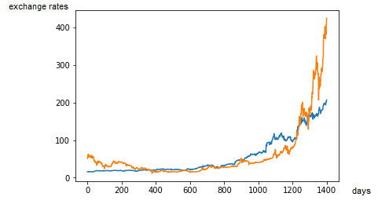
Scope
exchange rates from 1st January 2014 – 31st of October 2017
Cryptocurrencies (Bitcoin, Litecoin, Ripple)
Processor industry (Intel, AMD, Nvidia)
Stock indices (S&P500, Dax, Nikkei)
others (Gold, Oil)
blue: Nvidia exchange rates
orange: Bitcoin exchange rates /15

Slide 5
Data
Gathering:
Cryptocurrencies: https://www.coingecko.com/en
Problem: missing data for 2 whole weeks
Stock exchange: https://de.finance.yahoo.com/
Problem: weekends, holidays are missing
Preparing:
Uniforming data layout
Filling data on missing days (weekend, holiday)
Directly in Python, partly manually

Slide 6
Explorative Analysis
SNS Heatmaps
Kernel Density Estimate plots of Price/Percentage change
Comparison of percentage changes per day
Histogram of percentage changes

Slide 7
Monte-Carlo-Simulation
Monte-Carlo-Simulation
family of methods to simulate a large number of outcomes given a probability distribution
Simulation of 1000 possible future stock exchange
rate developments

Slide 8
Monte-Carlo-Simulation
calculate mean of all simulations
CAGR - mean annual growth rate of an investment
Annual Volatility - variation in stock price over a year
Graphs:
Price Series
Histogram of daily returns
Monte-Carlo-Simulation of stock rates
Histogram of simulated data (with quartiles)

Slide 9
Monte-Carlo-Simulation
Simulation using multivariate normal distributed data
Covariance between two exchange rates
Fan-Chart - to show ranges of simulations (quartiles)
(Simulation on Copula)

Slide 10
Copula
describes dependence between random variables
used in finance industry
Clayton-copula: models and minimizes tail risk in portfolio optimization applications
actions of each individual trader have an interaction effect with other traders → copulas allow us to analyse the interaction effects
interesting when exchange rates are going down, because then investors tend to herd their decisions

